Slide 1


SWARNA BHARTHI INSTITUTE OF SCIENCE & TECHNOLOGY
DEPARTMENT OF ELECTRONICS & COMMUNICATION ENGINEERING
A MAJOR PROJECT STAGE-II
ON
“WIRELESS SYSTEM FOR TRAFFIC SIGN IDENTIFICATION AND VIOLATION MONITORING”
UNDER THE GUIDANCE OF:
MS.P.NAGA LAXMI, M.TECH
ASSISTANT PROFESSOR
Presented by: IV-ECE
N.MANIKUMAR(18M61A04A7)
HEAD OF THE DEPARTMENT:
Dr.K. AMIT BINDAJ M. Tech, Ph. D, MIEEE
PROFESSOR

Slide 2
CONTENTS
ABSTRACT
INTRODUCTION
BLOCK DIAGRAM
HARDWARE REQUIREMENT
ADVANTAGES
APPLICATIONS
RESULT
CONCLUSION
REFERENCES

Slide 3
ABSTRACT
In the field of Vehicular automation, the detection of traffic signs plays a vital role. Enormous growth has been faced in the field.
Violating the traffic sign rules might lead to accidents where the life of people would be at stake.
Hence, to avoid these problems this project has proposed a prototype in such a way that, it detects the traffic signs and acts accordingly denying the user’s control in real-time if he tries to violate the rules in the traffic sign.
The prototype contains a traffic system, which is controlled with an Arduino controller.

Slide 4
INTRODUCTION:
Travel is an important part of today’s fast-paced life as everyone has to move around for their day-to-day life.
Road transport is the most commonly used mode of travel due to its ease, low cost, and availability to the common man.
Increase in population and traffic has resulted in traffic jams and traffic rules violations.
An accident survey estimated that around 3,00,000 accidents occur on Indian roads every year.
Violation of signals results in a number of accidents. The major problem is the manual tracking of every single vehicle that violates signals.
This problem can be brought under control if the tracking can be automated along with calculating and updating the fines.
In the existing systems, the tracking of signal violations is implemented using image processing techniques.

Slide 5
PROPOSED TECHNOLOGY
RFID based violation systems use radiofrequency waves to identify the vehicles that are endowed with unique identification numbers in the form of RFID tags.
RFID is one of the upcoming technologies in the field of engineering and innovation. It has a number of applications in the market starting from vehicle identification at tolls to security systems at malls.
The RFID based system consists of 3 main components, namely
FFID Reader.
RFID Tags.
RFID database.

Slide 6
BLOCK DIAGRAM OF THE PROJECT
switch
ARDUINO
16X2 LCD
Traffic light
RFID
Modem
Max-232
GSM
Tag

Slide 7
HARDWARE COMPONENTS
ARDUINO CONTROLLER
RFID Reader
RFID Tag
LCD
GSM
TRAFFIC LIGHT.

Slide 8
ARDUINO CONTROLLER:
Arduino is a prototype platform (open-source) based on an easy-to-use hardware and software.
It consists of a circuit board, which can be programmed and a ready-made software called Arduino IDE (Integrated Development Environment), which is used to write and upload the computer code to the physical board.
You can control your board functions by sending a set of instructions to the microcontroller on the board via Arduino IDE.
the Arduino IDE uses a simplified version of C++, making it easier to learn to program.

Slide 9
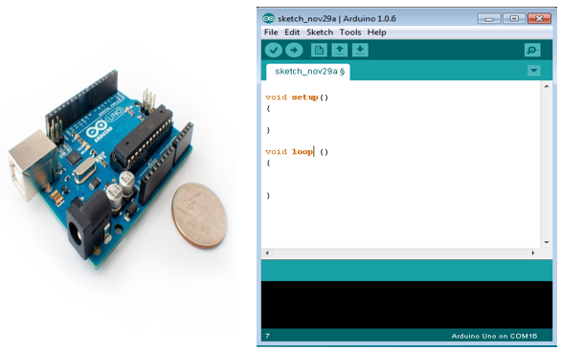
FIG : ARDUINO UNO

Slide 10
SWITCH:
A switch is a device in a computer network that connects other devices together.
Multiple data cables are plugged into a switch to enable communication between different networked devices.

Slide 11
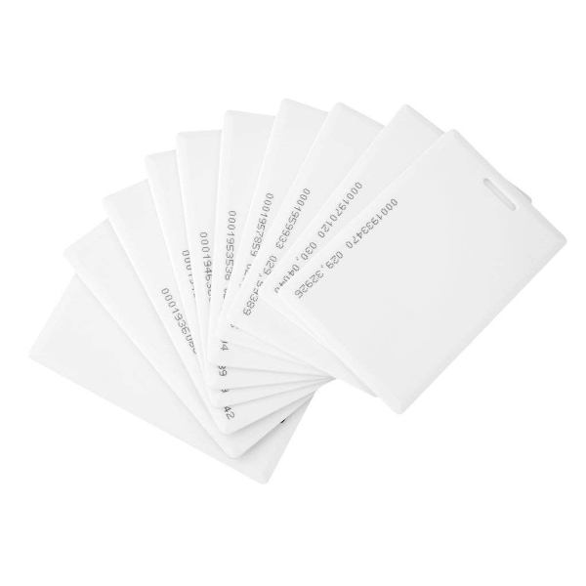
RFID READER:
The RFID reader is a network-connected device that can be portable or permanently attached.
It uses radio waves to transmit signals that activate the tag.
RFID TAG:
Radio Frequency identification uses electromagnetic fields to automatically identify and track tags attached to the objects.
An RFID consists of a tiny radio transponder, a radio receiver, and a transmitter.
LCD:
LCD stands for liquid crystal display.
A liquid crystal display is a flat-panel display or other electronically modulated optical device that uses the light modulating properties of liquid crystals in combination with polarizers.
Liquid crystals do not emit light directly, instead of using a backlight or reflector to produce images in color or monochrome.
RFID TAGS/CARDS

Slide 12
TRAFFIC LIGHT:
Traffic lights, traffic signals or stoplights are signaling devices positioned at road intersections, pedestrian crossings, and other locations to control flows of traffic.
The Reasons TRAFFIC LIGHTS are RED, YELLOW, GREEN
RED:
Red is an inherited symbol from railroads.
GREEN:
Green means caution at first.
YELLOW:
YELLOW means caution because it’s almost as easy to see as red or green.

Slide 13
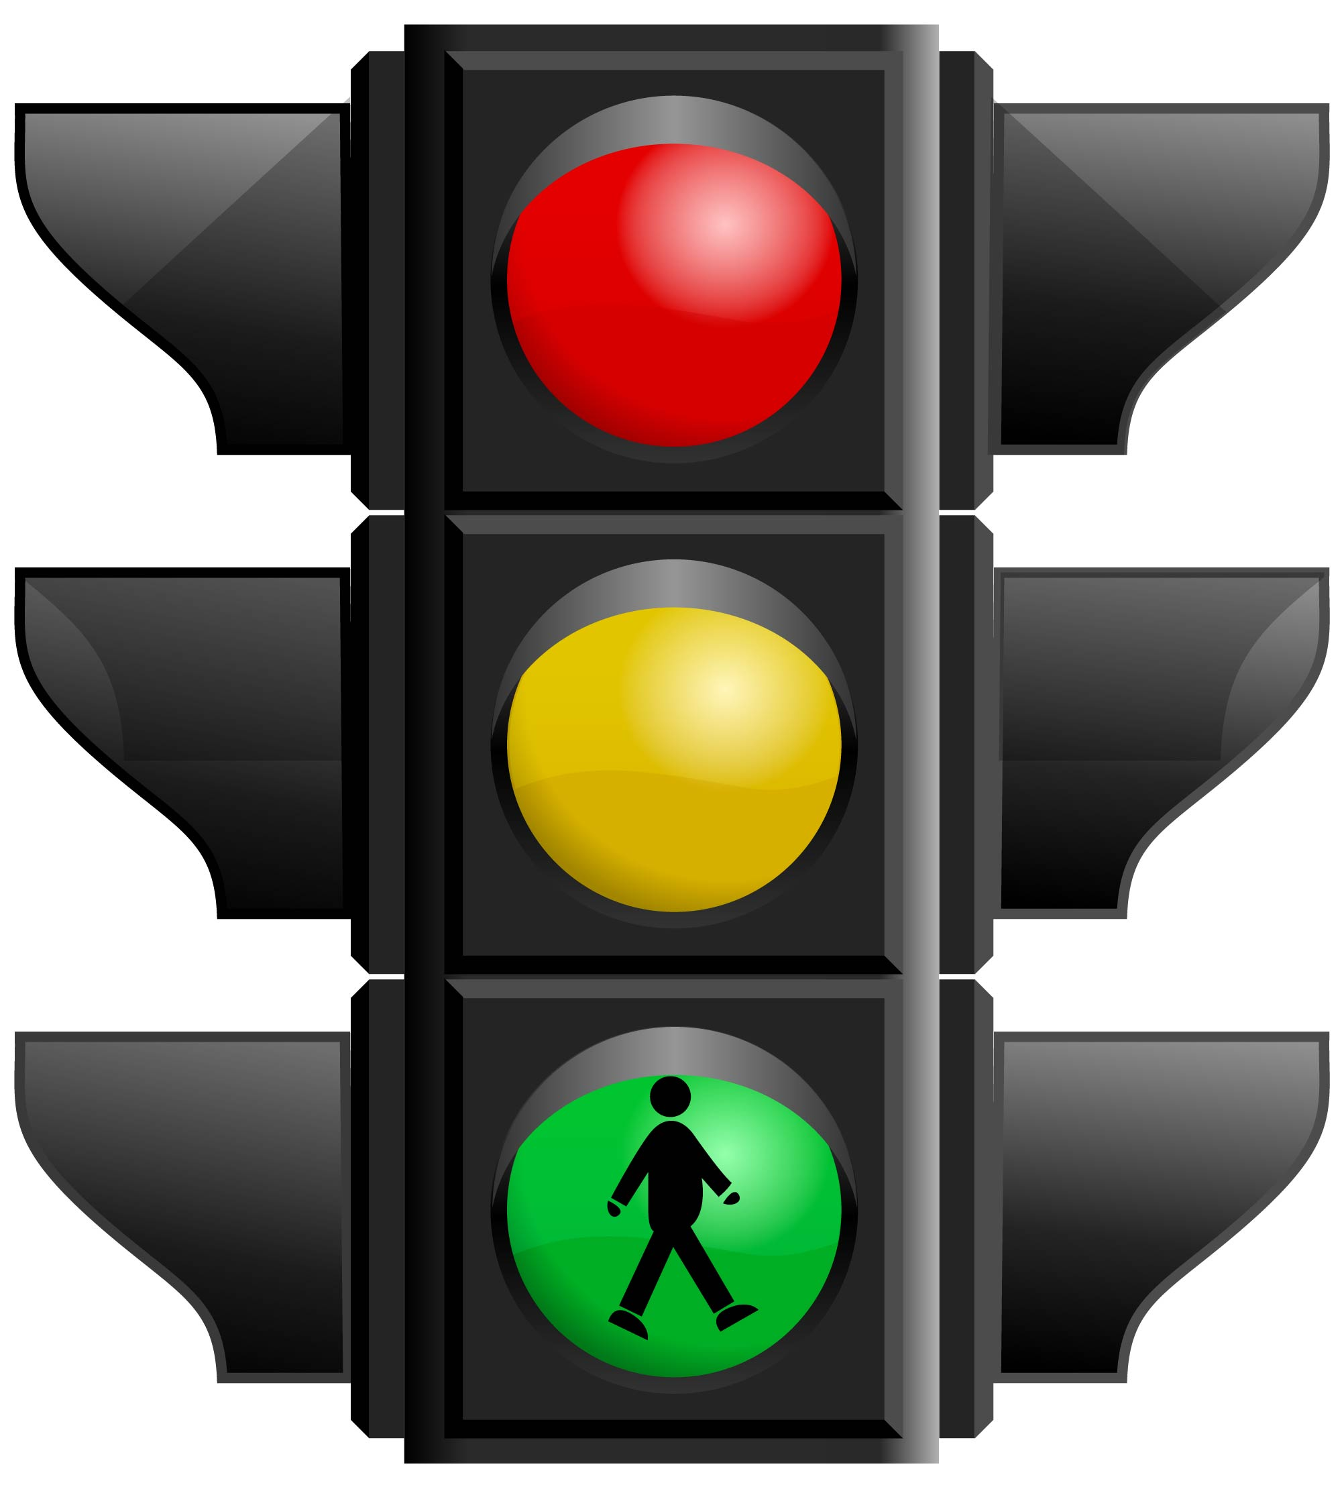
TRAFFIC LIGHTS are RED, YELLOW, GREEN

Slide 14
GSM:
It is used for data security and data transmission.
The GSM technology is used which uses mobile stations, base stations, and network systems.
The mobile station consists of the basic mobile access point or the mobile phone and links the mobile phones with the GSM network for communications.

Slide 15
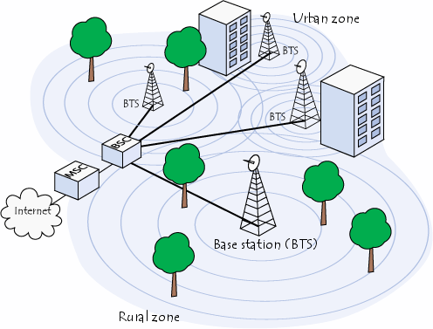
FIG : GSM NETWORK OF ARIAL VIEW

Slide 16
ADVANTAGES :
Reduce traffic jams
Prevents accidents.
Reduces violations.
Applications :
Traffic regulations and management.
Traffic monitoring
The project keeps the track record of drivers regarding parameters like insurance, license.
Better management of traffic.

Slide 17
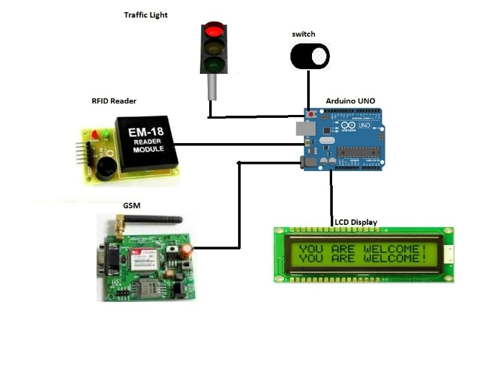
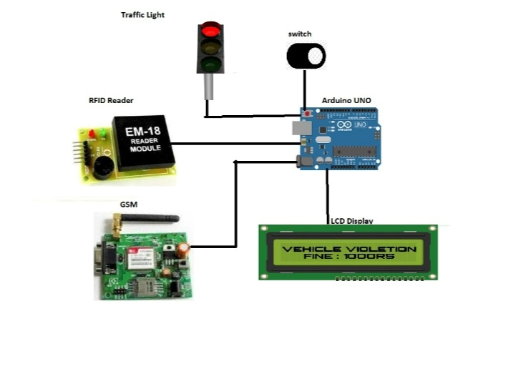
RESULT:
1
2
Whenever we on the kit it displays the message YOU ARE WELCOME on LCD.
In activation mode, if any vehicle jumps or violates the traffic rules then automatically the RFID tag reader detects the vehicle and sends a message to the user with the help of GSM. Meanwhile, we can observe the LCD screen that displays vehicle violations and a fine of 1000RS.

Slide 18
CONCLUSION:
We have proposed a system for automatic detection and penalty management of signal violations which will in turn help to decrease the number of accidents.
The system also analyses the traffic flow on a given road at a given time according to the circumstances of the road. The proposed architecture is portable, accurate, and can be installed at a reasonable cost.
The system alleviates the need for traffic police at every signal to manually identify the violations. The system shows promising results in automatic detection, since the detection of the tag identification is more precise, reliable, and efficient in active RFID, leading to the implementation of corrective actions.
With the help of a wireless system for traffic sign identification and violation monitoring project, we can implement the traffic rules effectively, and also it will help in developing a smooth and flawless traffic regulation system.

Slide 19
REFERENCES :
1. Perez J, Seco F, Milanes V, Jimenez A, Díaz JC, De Pedro T, "An RFID-based intelligent vehicle speed controller using active traffic signals", Sensors, 2010 Jun 9, 10(6), pp: 5872-87.
2. Cheng-an ZT, Min-lu J, "A RFID Based Traffic Information Acquisition System and Vehicle Positioning Method", Journal of Electronics & Information Technology, 2010, pp: 11-15. International Journal of Pure and Applied Mathematics Special Issue 326
3. Pandit AA, Mundra AK, Talreja J, "RFID tracking system for vehicles (RTSV)", In Computational Intelligence, Communication Systems and Networks (IEEE), 2009, CICSYN'09, First International Conference on 2009 Jul 23, pp. 160-165.
4. Min Z, Wenfeng L, Zhongyun W, Bin L, Xia R, "A RFID-based material tracking information system", In Automation and Logistics, 2007 IEEE International Conference on 2007 Aug 18, pp. 2922-2926.

Slide 20


